Slide 1

12
Adjectives with –ed/-ing
Make a Wish

Slide 2
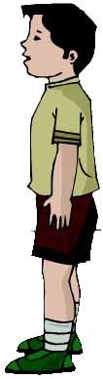
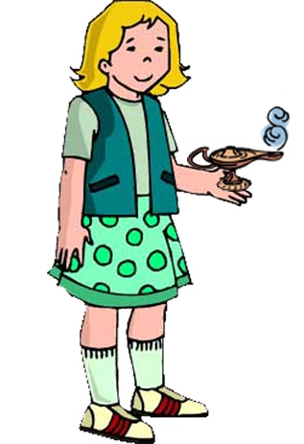
A Typical Family 1
Look what I found on the street!

Slide 3
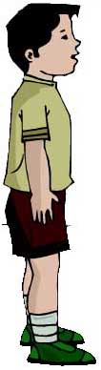
A Typical Family 2
It looks like a magic lamp. Let’s see if there’s a genie inside.

Slide 4

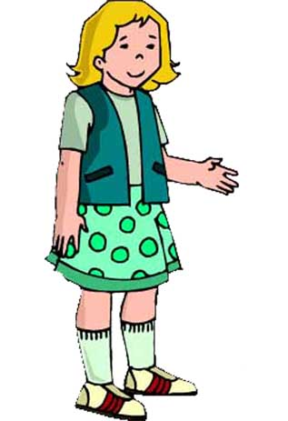

A Typical Family 3
You each have one wish.
SPEAK!

Slide 5
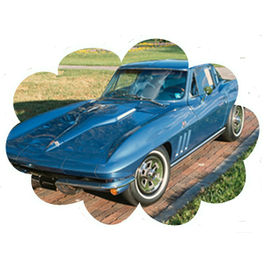
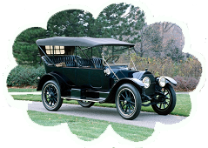
Adjectives 1
That’s an old and boring car. I want an interesting car!
I want a car.
A blue car! Cool!
One wish? OK.

Slide 6
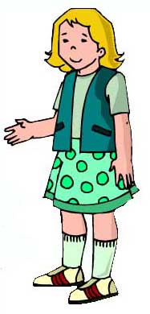

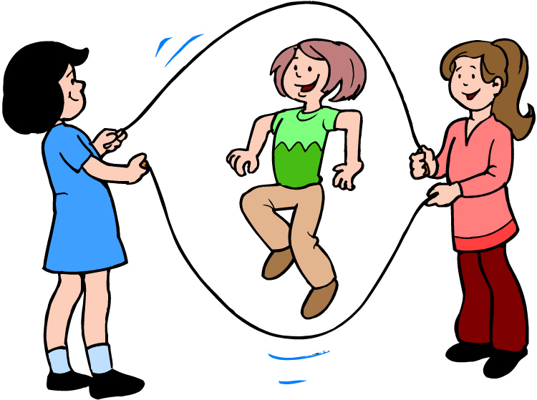
Adjectives 2
Those guys are boring. I want some exciting friends.
I’m bored. I want some friends.

Slide 7
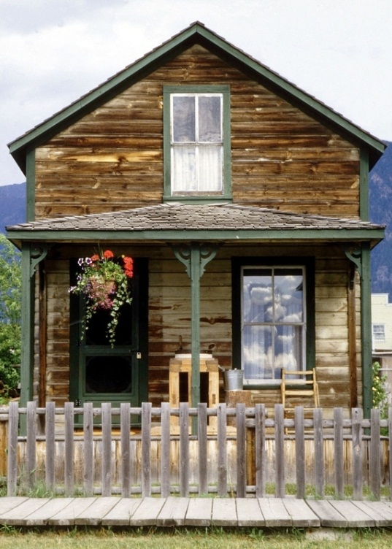
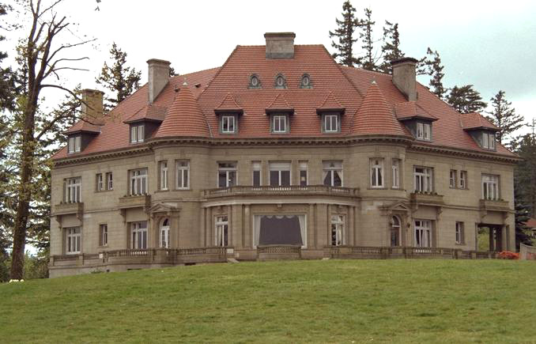
Adjectives 3
I want a house.
Wow! That’s perfect!
That house is small. I am disappointed. ☹ I want a big house.

Slide 8
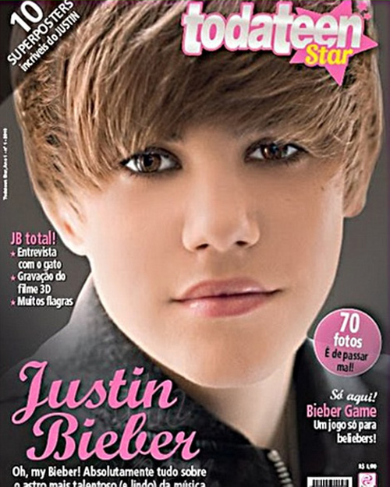
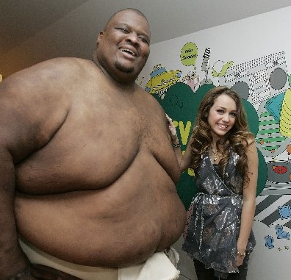
Adjectives 4
That is not shocking news.
I want some shocking news.
Justin Bieber is a girl
Miley´s new boyfriend

Slide 9
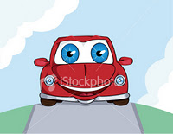
The car is excited…
The man is very excited. He has exciting news.

Slide 10
Which is correct?
That house is bored or boring?
She is excited, and her friends are exciting.

Slide 11
I want an amazing house
I want an exciting car

